Slide 1
Case Study - Luxury Retailer

Slide 2
Introduction to dataset
Dataset includes details of a luxury retailer.
Given dataset is split in 4 different csv files:
Customer Registration details are in Customer_Registration file
Sale details for March, April, May in files Sale_April’16, Sale_May’16 and Sale_June_16 respectively . Sale is segregated into Quantity (Number of pieces) and Amount (USD – Revenue)
Method used
Data Wrangling
Exploratory Data Analysis
Data Visualization

Slide 3
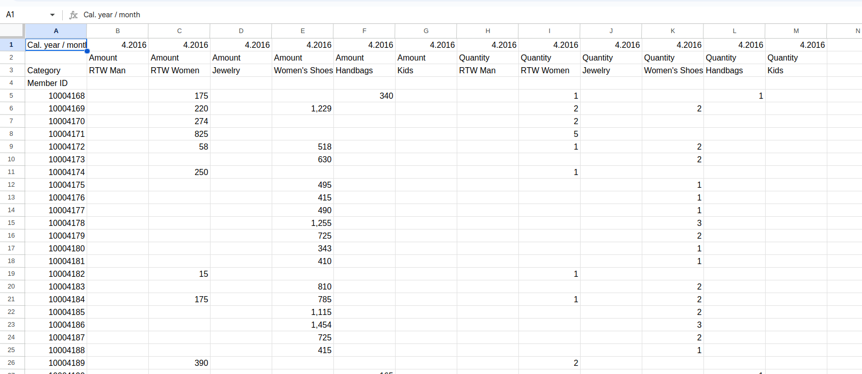
1.As the cal year / month is having same value for all column Hence remove that complete row
2. Rename the feature name as half of them are categorized Amount and another half as quantity

Slide 4
Data Wrangling - Using the pandas
1.Load the four csv dataset using read_csv(filepath)
2. Using the standard python library Pandas function understand the dataset
3. Using shape - identifies the no of rows and column, head / tails by default load top/ last five rows
4. Using info()-prints full summary about the dataframe with dtype and null value counts and memory storage
5.Describe -function produces descriptive statistics for the dataframe, that is, the central tenency (mean, median, min, max, etc.), dispersion, etc

Slide 5
Exploratory Data Cleaning
Step 1.
Data cleaning- with the help of isnull(). Analyise 70 % of the data have null/ empty value . furtherly it is not suggested to remove/ delete data so much . As it will not remove the empty cell also leads to information loss
To treat missing value . I have imputed/ filled those empty values with 0 using fillna()
For all 3 month sale data

Slide 6
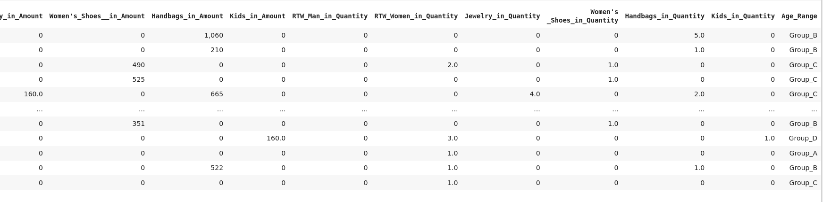
Step2:
Replace the range values of Age Range with Particular Group name and merged th cust_df with march sale, april sale, may sale data
Identity the important features of data drop those features which are not required / unnecessary for data analysis

Slide 7
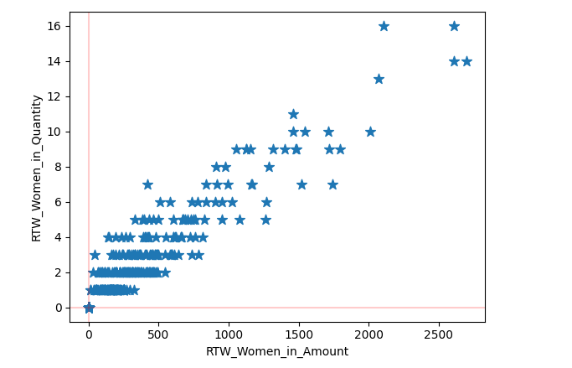
Bivariate analysis

Slide 8
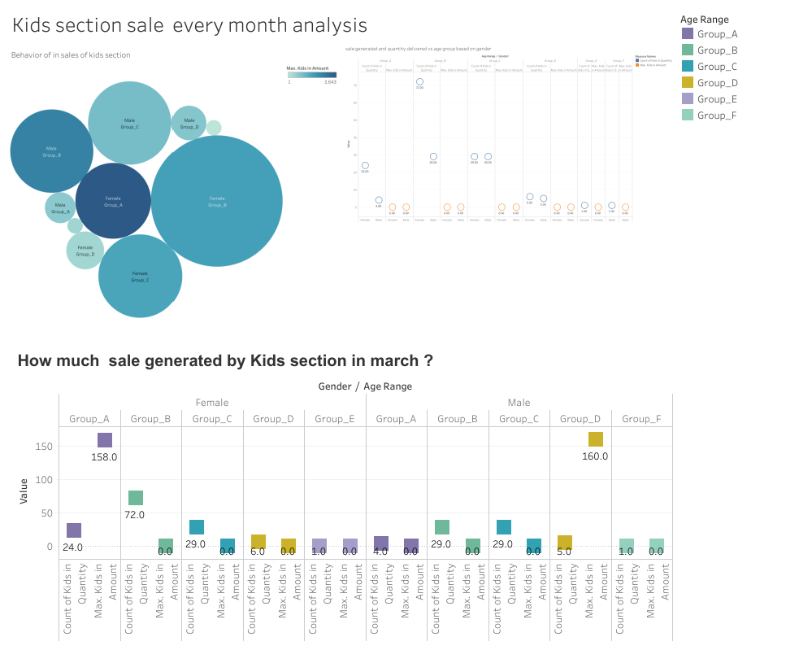
Data visualization

Slide 9
Points for Dashboard 1
Female whose age is belongs Group A female has shopped maximum 158$ in kids section in the month of march .
Male who belongs to and Group D has spend maximum sale of 160 $ buying clothes , toys for kids in march month
Female and Male whose age is between 30-40 and are just married will look clothes, toys and quality products for their kids as they regular order baby product in quarterly .Luxury retail delivered 29 items for kids section In march
Female whose age is above 50 doesn,t buy any products from Kids section in march
Female who falls in age Group B has ordered maximum order ie 72 order from kids section in march
In month of april revenue has not generated in Kids section from both male and female irrespective of their age
Both Female and Male above the age of 50 has not placed order in kids section
As same trend from march female who falls in group has placed the highest order ie 72 order in kids section in april month
Female whose belongs to group A who has generated maximum sale of 3600$ while male whose age group B has generated maximum of 2900$ in kids section in month of may
Even in may both Male and female has placed 29 ordersin kids section

Slide 10
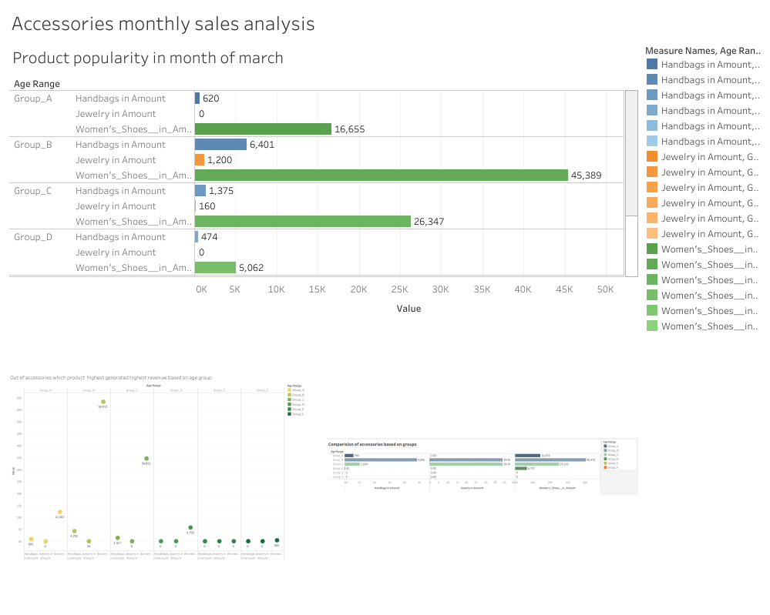
dashboard 2

Slide 11
Points for Dashboard 2
In month of march on the collection of accessories womens shoes being the most popular product which has generated total 45000 $ revenue for luxury retailer
In Group A womens shoes has sold mostly and generated revenue of 16000$
In group C and D you can see the sale of womens shoes has rapidly decreased from 26000 $ to 5000$
Group A and Group D has not generated single dollar in jewellery while Group B mad 6000 $ sale
In april group has generated 10000 $ more revenue in women shoes while group A has generated 4000$ less than revenue from previous month
Compare to april month group has generated revenue as difference 15000$ less
Except group B allother group has generated 0 $ revenue in month of april in jewellery section
Group B and Group C has generated 39 $ in jewellery in month of may
Group B has generated average 4000$ -5000$ revenue in handbags varies in april march and may

Slide 12
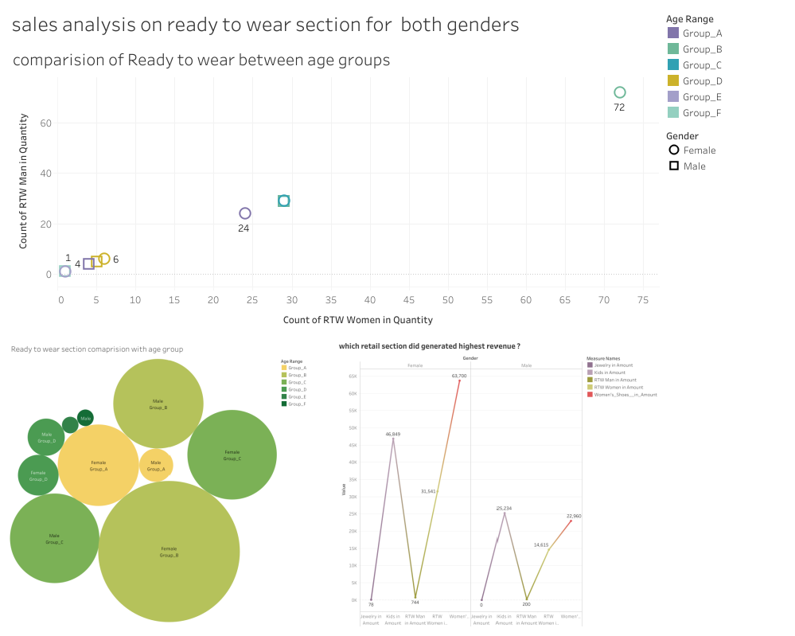
Dashboard 3

Slide 13
Points for Dashboard 3
Group B has ordered Highest quantity ready to wear clothes / readymade clothes for men and women section in month of march
Group E and Group F has not placed any order for RTW clothes for both genders in month of march
Group A female has placed 29 order in Luxury retail of RTW clothes while Group A Male has placed only 4 orders of RTW clothes in march
Group C male has placed the minimum order of all other group in RTW clothes
In month of april female who falls under group B has generated highest orders
Group C female has ordered 50 quantities less than Group B for RTW clothes in month of april
Customers Irrespective of gender of group C has placed equal quantities ie 29 orders of RTW clothes in month of april
In the month of may female has generated th 30000 has total revenue in RTW womens section

Slide 14
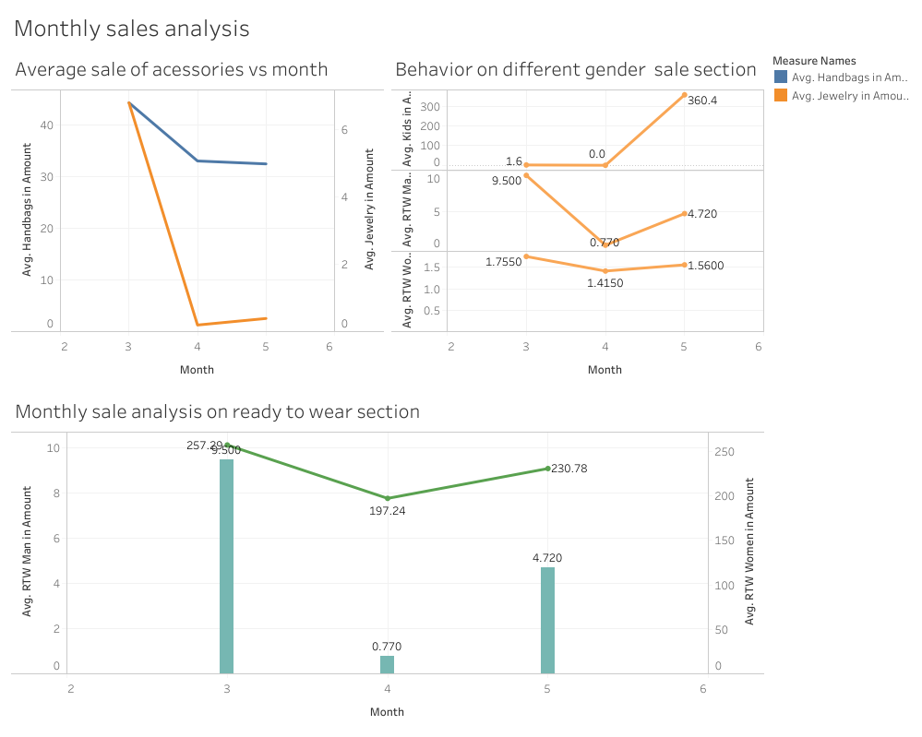
Dashboard 4

Slide 15
Points for Dashboard 4
Compare the average sale of accessories like handbag and jewellery In the month march handbag has made average sale of 44$ which further declined to 33$ sale in april . After april there is slight decrease of 1$ difference
If you look the behavior sale of the jewellery . At beginning of quarterly month ie march the average sale made was 6.8$ after the end of march month there sharp decline in average sale which is 0.19 $ then there is slight 0.1$ increase for average sale compared to april month
From the start of quarter avg sale of women RTW is 258$ where in april calculated avg sale is 50$ less .after end of april the sale increase then average sale calculated 230$ while looking at Men RTW sale 9.5 was average sale . then sharp decrease to 0.7 $ as average sale in month of april .As variation there is a huge rise sale after calculating the sale is 4.6 $ as avg sale
In the month of march and april the avg sale was near 0 by end of may there is sharp rise in sale and after calculating average sale which 360 $

Slide 16
Business Recommendation
Customer of Age 20-30 care about how they look They are willing to experiment on their look .they are contributors generating profitable sales in all three months
Kids sale is being most unpopular section to customers for all 3 months
Customer above the age of 45 are less curious and their looks and mostly dont prefer the RTW women section
Ready to Wear women gives more profit in generating revenue and sale of order compare to RTW MEN

Slide 17
Future Analysis
Further month analysis. We need to focus on the age group below 20 and age group 30-40 .to add provide on male section and provide the wide variety choices
There should offer on accessories like hand bags and jewelry for register member
To perform better on other section it is important to have customer feedback on product

